Slide 1

Data Engineering: 2022 FIFA World Cup
Solution_Makers
Members:
Dariel Ibanez
Nelson Velasco
Mia Serrano-Salow
Patricia Young

Slide 2
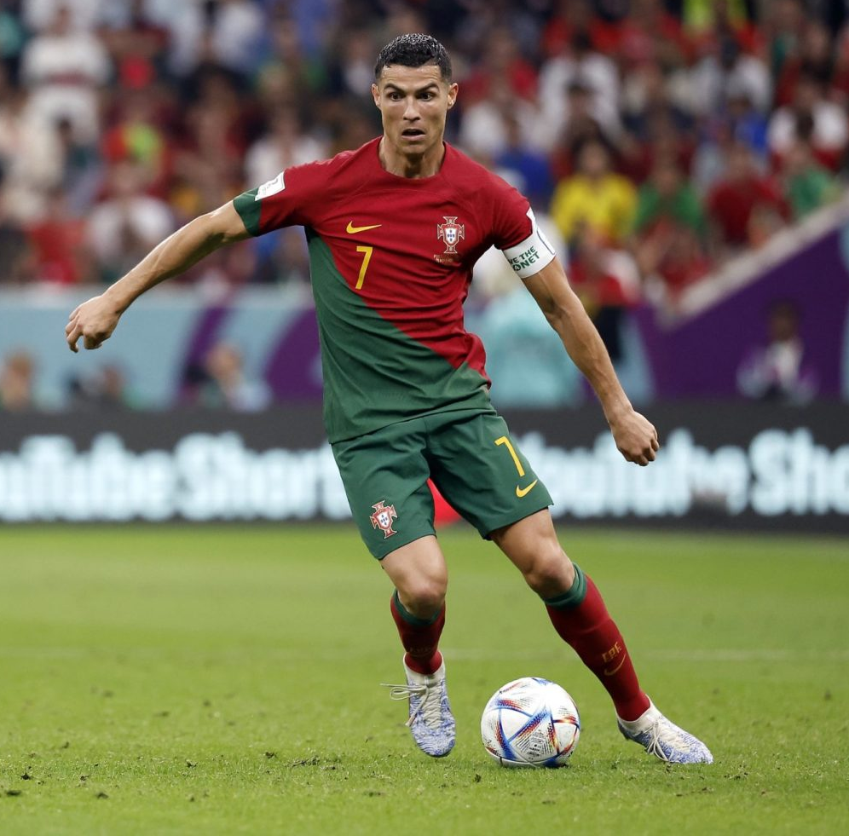
Purpose:
We are a team of sports data engineers researching player data for soccer team scouts to use to determine the best players to recruit.
We have been asked by a client company to process and upload player data from the 2022 FIFA World Cup for them to choose the best players for their team.
We have determined which players are the best based on their skills and performance in the 2022 FIFA World Cup. We have defined "best" by analyzing the relationships between players' number of goals, touches, assists, passes, etc.
We have chosen to work in the sports field because it is a topic we are all knowledgeable about and interested in.

Slide 3

Questions:
As sports data engineers working for scouting companies, some questions that we considered while performing our research were:
What factors should determine what makes the players the “best”?
Who are the players that out performed their market value during the FIFA World Cup?
Who had the most number of goals out of all the players in the FIFA World Cup?
Which players had the most touches per the amount of minutes per game?

Slide 4
Applications Used:
The datasets that we used were found on Kaggle and were csv files.
The csv files were imported into Jupyter Notebook and ‘cleaned’. We transformed and cleaned the data in the Jupyter Notebook using both Pandas and Polars.
Next, we exported the data as csv files and loaded them into pgAdmin and created a SQL database. We wanted to created several tables to be able to better manage the larger dataset.
We then exported the data back out of pgAdmin and back into the Jupyter Notebook to ensure things were working properly.
We used QuickDBD to create the ERD.
We used AskBCS for when we had trouble or questions.
Notes:
Can speak about why we chose the Kaggle datasets.
Why we chose to clean the data in the juypter notebook/python and use pandas/polars.
Why we opted for a SQL database and not a NoSQL database (we had a more structured dataset to work with which worked better with a SQL database, and we wanted to then use tables to manipulate the data to see trends and that would be better suited in a SQL database)

Slide 5
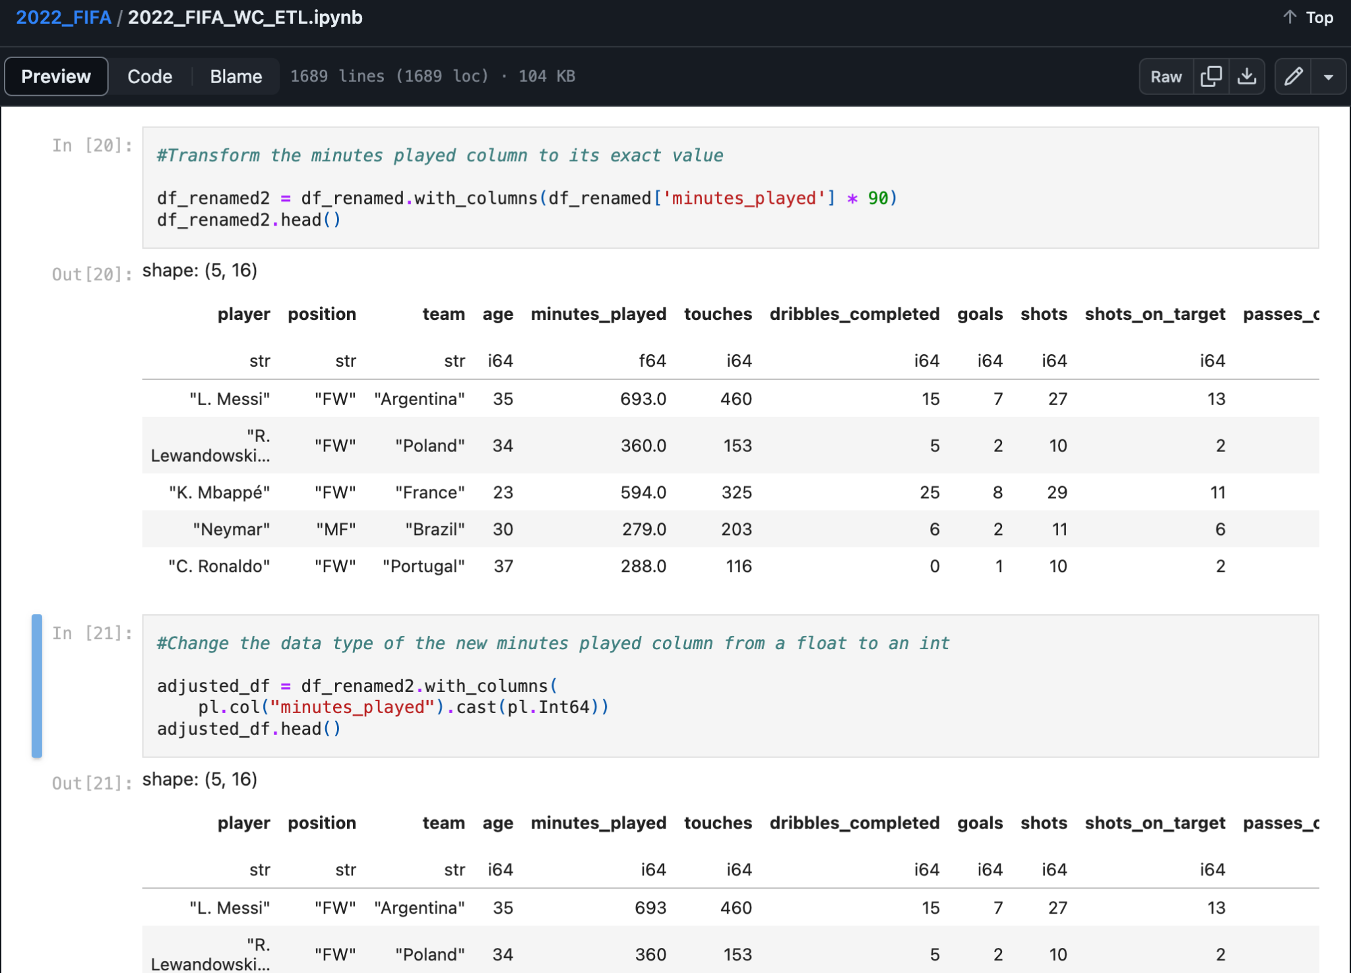
Transformation of Time

Slide 6
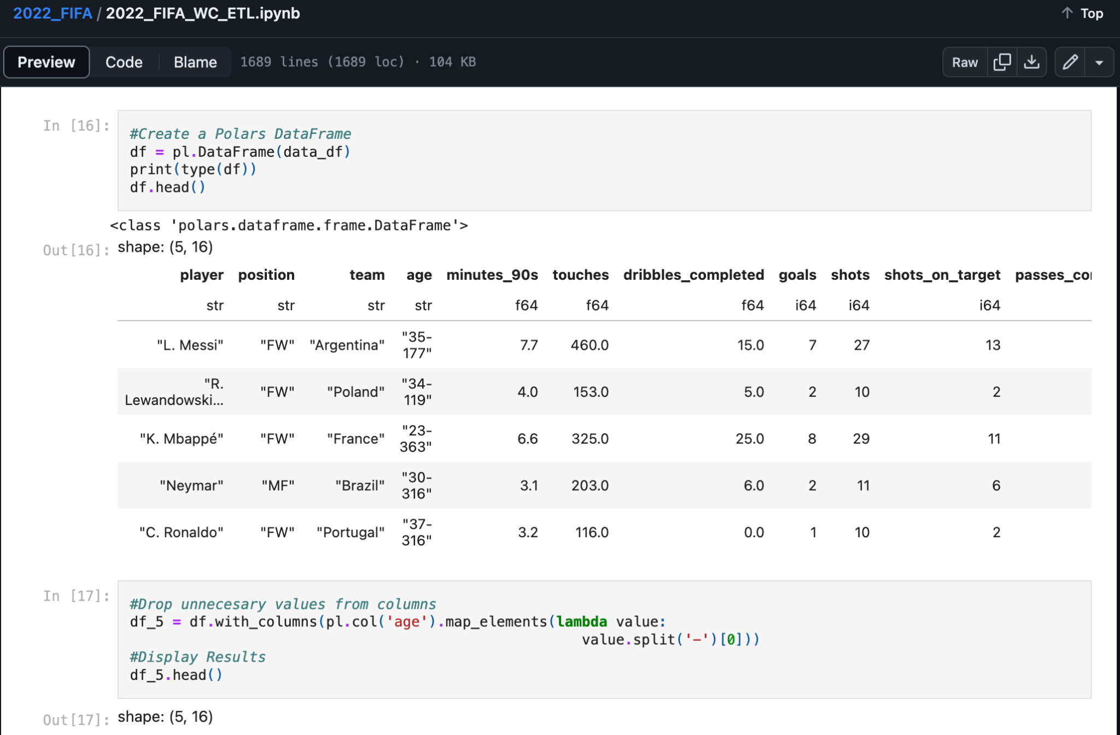
Polars DataFrame & Dropping Columns

Slide 9
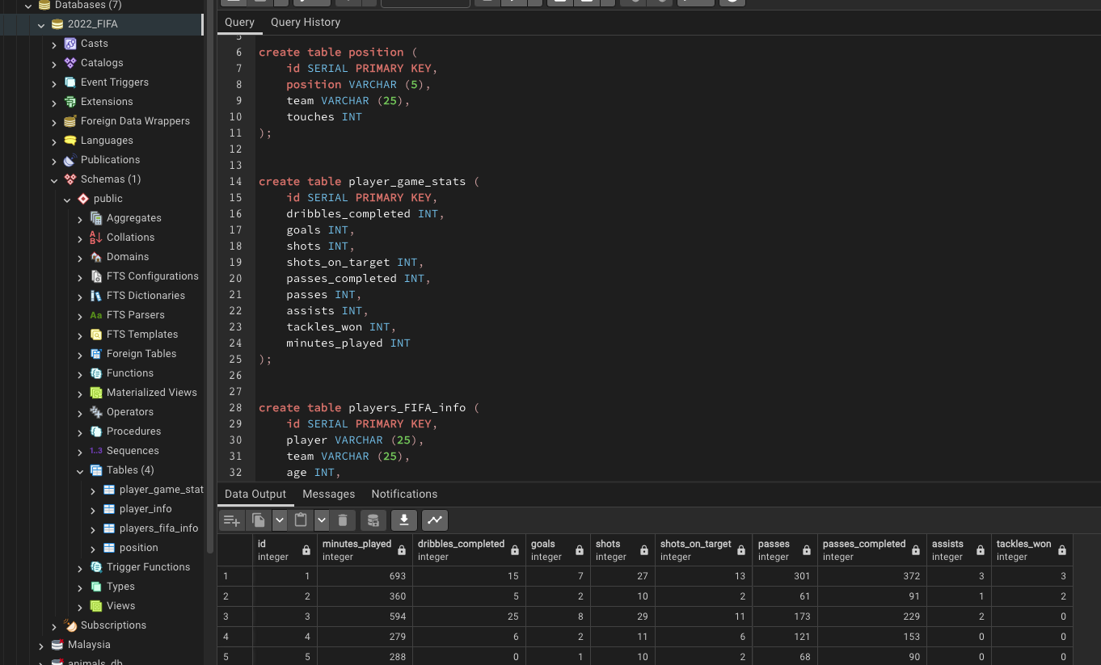
SQL Code for Tables

Slide 10
Entity Relationship Diagram (ERD)

Slide 11
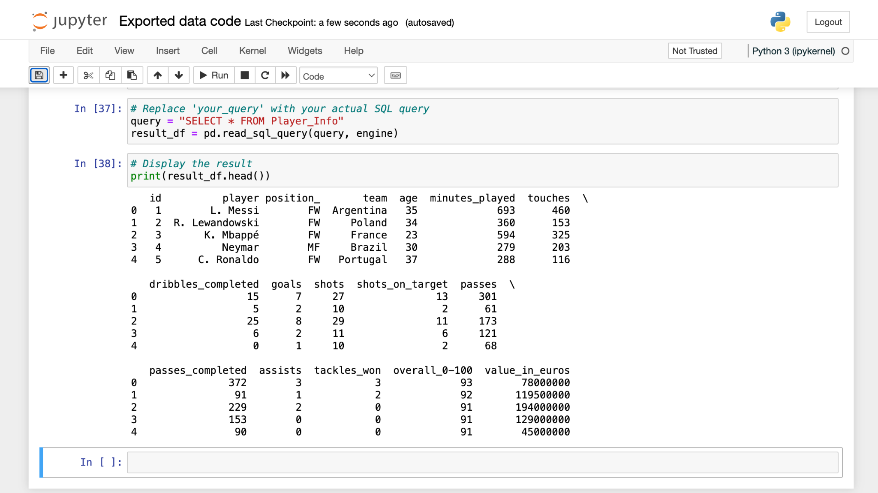
Exported Data

Slide 12
Ethical Considerations
Data privacy: We ensured that all of the data we extracted from Kaggle was compliant with data privacy regulations.
Consent: Since the data was extracted from Kaggle, a community platform that contains data free for public use, we obtained consent by agreeing to the site's terms and conditions.
Data usage: We maintained transparency in the ETL process by documenting all of the steps we took and made this information accessible to relevant stakeholders. We communicated the purpose of the data extraction and how we intend to use the data.

Slide 13
Thank you

